Slide 1
Quality improvement annual forum July 25, 2018
Welcome and
Thank You for all your Great Work!

Slide 2
The little things first . . .
Bathrooms
Breaks
Silence Phones
Taking Questions

Slide 3
BHS QI leadership team
Tabatha Lang, Chief, Agency Operations
Tim Tormey, Behavioral Health Program Coordinator, SUD QM
Steve Jones, Senior Quality Management Program Manager
Liz Miles, Principal Administrative Analyst, Performance Improvement Team (PIT)
AnnLouise Conlow, Senior MIS Manager

Slide 4
SYSTEM INFORMATION
Presented by
Tabatha Lang, LMFT
Chief, Quality Improvement

Slide 5
System requirements
Medicaid State Plan
Official contract between DHCS and Centers for Medicare and Medicaid Services (CMS)
Ensures compliance with federal requirements to be eligible for federal funding

Slide 6
System requirements
Medi-Cal Specialty MH Services 1915(b) Waiver
Agreement between Centers for Medicare and Medicaid Services (CMS) and DHCS
Allows California to deliver SMHS through a managed care delivery system
San Diego is a Mental Health Plan responsible for local administration and provision of SMHS
Current SMHS waiver term: July 1, 2015-June 30, 2020

Slide 7
System requirements
Mental Health Plan Contract
State and Federal laws
Outlines responsibilities and requirements
Conforms with federal requirements for Prepaid Inpatient Health Plans (PIHPs), as MHPs are considered PIHPs
Statutes and Regulations
Title 42, Code of Federal Regulations
California Welfare and Institutions Code commencing with 14700 et seq.
Title 9, California Code of Regulations, chapter 11, Medi-Cal Specialty Mental Health Services, commending with 1810.100 et seq.

Slide 8
Dhcs implementation efforts
1915(b) Specialty MH Services Waiver
Transparency
Data
Access
Timeliness
Quality
Translation Services
Improvement
Enhanced Monitoring
Sanction Fines and Penalties

Slide 9
Implementation efforts
Children and Youth System of Care Reforms
Continuum of Care Reform
Therapeutic Foster Care
Presumptive Transfer
Children’s Crisis Services

Slide 10
Implementation efforts
Managed Care Rule Implementation
Network Adequacy
Program Integrity
Beneficiary Protections
State Monitoring Requirements
Quality Improvement and Measurement (Quality Rating)
Parity Compliance

Slide 11
Outpatient chart review disallowance rates: statewide
Fiscal Year | # of MHPs Reviewed | # of Claims Reviewed | # of Claims Disallowed | % of Total Claims Disallowed
2012-2013 | 17 | 6286 | 2181 | 35%
2013-2014 | 19 | 7439 | 3508 | 47%
2014-2015 | 20 | 7623 | 3803 | 50%
2015-2016 | 17 | 7615 | 1383 | 18%
3-Year Cycle | 56 | 22677 | 8694 | 38%
San Diego, March 2018 |  | 367 | 10 | 2.7%

Slide 12
Triennial mhp review: System review compliance rates
Fiscal Year | # of MHPs Reviewed | Total # of Items in the Annual Protocol | Average % Out or Partial Compliance | % Range Out of Compliance
2012-2013 | 17 | 131 | 25% | 10%-62%
2013-2014 | 19 | 114 | 11% | 3%-29%
2014-2015 | 19 | 151 | 12% | 0%-33%
2015-2016 | 17 | 187 | 5% | 0%-19%
3-Year Cycle Average | 56 | 146 | 13% | 0%-62%
San Diego, March 2018 |  | 243 | 2.9%

Slide 13
DHCS ENHANCED MONITORING
DHCS to operationalize definitions (e.g., significant findings, substantial improvement, etc.) for criteria triggering enhanced monitoring and imposing sanctions, fines, and penalties
Temporary Suspension Orders
Suspension of the MHP’s specified personnel; and/or specified subcontractor

Slide 14
medicaid managed care final rule
Commonly referred to as the “Mega Regs”
Issued on May 6, 2016
Applies to the provision of Medicaid Managed Care (MMC) programs and managed care organizations (MCOs), Pre-paid Inpatient Health Plans (PIHPs), and Pre-paid Ambulatory Health Plans (PAHPs)
Mental Health Plans (MHPs) and Drug Medi-Cal Organized Delivery System (DMC-ODS) pilot counties are classified as PIHPs and must therefore comply with the federal managed care requirements

Slide 15
Medicaid managed care final rule
Implementation of the new federal regulations is currently in process and will occur in phases. They include:
Parity
Network Adequacy
Enrollee Rights
Grievances and Appeals
New Managed Care Quality Rating System
Program Integrity

Slide 16
Medicaid managed care final rule
Key goals are:
To support State efforts to advance delivery system reform and improve the quality of care
To strengthen the beneficiary experience of care and key beneficiary protections
To strengthen program integrity by improving accountability and transparency
To align key Medicaid and CHIP managed care requirements with other health coverage programs

Slide 17
Network adequacy
Counties must comply with time and distance standards for adult and pediatric behavioral health (mental health and substance use disorder services) providers.
Based on population density: rural, small, medium, or dense
Time and Distance Standards
Dense (San Diego)
15 miles/30 minutes
An alternate access standards request can be submitted to DHCS for regions that do not meet the time and distance standards.

Slide 18
Network adequacy
Availability of services (i.e., timely access to care)
Timely Access Standards: Psychiatry
Within 15 business days
Outpatient: Mental Health
Within 10 business days
Outpatient: DMC-ODS
Within 10 business days
OTPs DMC-ODS
Within 3 business days
Urgent care appointment that does not require prior authorization
Within 48 hours of request
Urgent appointment that does require prior authorization
Within 96 hours of request

Slide 19
Network adequacy
Assurance of service capacity
Range of services appropriate and adequate for the anticipated number of beneficiaries for the service area
Sufficient number, mix, geographic distribution of providers in the network, within the scope of practice under State law, to meet the anticipated number of beneficiaries in the service area.

Slide 20
Network adequacy
Required Documentation
Network Adequacy Certification Tool (NACT)
Geographic access maps
Actual grievances and appeals
Provider agreement boilerplates
Provider directory
Beneficiary satisfaction survey results
Specific policies and procedures
Report significant changes in operations to DHCS within 10 business days

Slide 21
Beneficiary support & protection rules
Information Requirements
Language and format
Information Content
Member Handbook
Provider Directories
Taglines

Slide 22
Beneficiary support & protection rules
Grievance and Appeal Systems
Updates to timelines
Notice of Adverse Benefit Determination (NOABD) to replace Notice of Action (NOA)
16 NOABDs
Including but not limited to: Grievance resolution notice, denial of service notices, payment denial notice, timely access notice, financial liability notice, rights attachment, authorization related notice and language assistance taglines

Slide 23
Program integrity
Conflict of Interest Safeguards
Ownership, control and relationship information
Provider Selection
Provider Enrollment, Credentialing & Re-Credentialing Requirements

Slide 24
DMC-ODS: The County of San Diego SUD Health Plan
Health and Human Services Agency
Tim Tormey, Psy.D. - Behavioral Health Services
SUD QM Program Coordinator
Notes:
This is a very brief snap-shot presentation about the DMC-ODS. Resources on last slide of where you can learn more.

Slide 25
DMC-ODS – SUD Health Plan
MHP | DMC-ODS
Beneficiary Rights | Beneficiary Rights
Informing materials JFS/CCHEA | Informing materials JFS/CCHEA
Specialty Mental Health Services | Expanded services (examples) Case Management Individual Counseling (without previous restrictions) Residential treatment (without previous restrictions)
Access Standards | Access Standards
Time/Distance Standards | Time/Distance Standards
Provider Directory | Provider Directory
Notes:
Like the county has a contract with the Department of Health Care Services to provide specialty mental health services as part of a Mental Health Plan, the County now has a contract with DHCS to provide SUD services as a type of health plan. It’s called the Drug Medi-Cal Organized Delivery System (DMC-ODS) plan, and we “went live” with this new system on July 1, 2018.
There is more similarity between these systems now. (Discuss examples from slide).

Slide 26
Culture shifts
Program centered
Phases/fixed lengths
Single program model
Episodic Care
Wait for “rock bottom”
Client centered & Integrated
Individualized intensity/time
Utilization of various EBP
Continuum of care
Capture all opportunities to connect
clients
Notes:
Implementing the DMC-ODS is a great opportunity – but as with every opportunity for change, there are culture shifts. Some of the shifts from the previous “State Plan” version of Drug Medi-Cal reimbursable services to the DMC-ODS include:
A move from program centered treatment to client centered and integrated treatment. – Discuss IOT example – 3 hours/3 days a week minimum. Mostly groups – now combination of services, based on client’s individualized need.
Fixed lengths (example – residential. Now based on medical necessity, fluidity to move up and down the continuum of care).
Single program model to EBP – expanded approach incorporating EBPs (Minimum MI/Relapse prevention) into other models.
Episodic – Continuum. Expanded length of service based on transitions through an organized system vs. Separate treatment episodes.
Rock bottom – client connection. Shifting from the sense that client needs to lose everything to get clean/sober to meeting clients where they’re at, and though comprehensive assessment, linking them to the appropriate level of care – what we refer to as receiving the right care, at the right time, for the right duration.
Comprehensive assessment is based on use of the American Society of Addiction Medicine (ASAM) Criteria (Next slide)
Refer to slide content
Integration of Social Model with Medical Model
Individualized care with LOS dictated by ASAM
EBP to include MI, Relapse Prevention, Recovery Residences
[NEXT SLIDE]

Slide 27
Asam criteria
1. Acute Intoxication and/or Withdrawal Potential
2. Biomedical Conditions and Complications
Exploring an individual’s health history and current physical condition
4. Readiness to Change
Exploring an individual’s readiness and interest in changing
3. Emotional, Behavioral, or Cognitive Conditions and Complications
Exploring an individual’s thoughts, emotions, and mental health issues
5. Relapse, Continued Use, or Continued Problem Potential
Exploring an individual’s unique relationship with relapse or continued use or problems
6. Recovery/Living Environment
Exploring an individual’s recovery or living situation, and the surrounding people, places, and things
Exploring an individual’s past and current experiences of substance use and withdrawal
*Clinical Judgement
Notes:
How many are familiar with ASAM Criteria?
Briefly describe each dimension.

Slide 28
ASAM Levels of Care
ASAM Level of Care | Description
OTP Level 1 | Opioid Treatment Programs
Level 1 | Outpatient Services (OS)
Level 2.1 | Intensive Outpatient Services (IOS)
Level 3 | Residential 3.1 – Clinically Managed Low Intensity 3.2 – Withdrawal Management 3.5 – Clinically Managed High Intensity
Level 4 | Medically Managed Intensive Inpatient Services
Notes:
Based on this comprehensive assessment, level of care determinations are made to individualize treatment and assure the client is receiving the right treatment, right time, etc.
Briefly describe the treatment levels that are part of the first year.

Slide 29
Resources on ASAM
BHETA
Two one-hour overviews (ASAM Part 1 and 2)
CIBHS
Two webinars (ASAM A and ASAM B)
Notes:
MH programs are not expected to be trained on ASAM – however, some MH programs have expressed interest in learning more so here are some resources for you.
BHETA – overviews.
CIBHS – more in-depth. (Flyer in packet).

Slide 30
CASE MANAGEMENT/ Care coordination
“Warm hand-off”
Notes:
Case management and care coordination are central to an effective continuum of care – SUD programs will be working to follow warm hand-off processes to assure clients with a SUD diagnosis and other needs, such as MH, don’t “Fall through the cracks.” Just pointing this out as you may see increased contact from SUD case managers for clients with MH needs.

Slide 31
CASE MANAGEMENT/ Care coordination
Access and Crisis Line –
Brief screening to determine provisional ASAM Level of Care
Can be used by Mental Health programs to facilitate linkage to SUD services
Notes:
On the MH side, you can assist with linkage to SUD programs as clinically indicated. In lieu of learning ASAM to determine level of care, you can assist clients to access the ACL.

Slide 32
Moving forward
Meeting Network Adequacy Standards
IT developments/Information Sharing
Strengthen Care Coordination Partnerships
Physical Health
Mental Health
Notes:
There’s so much more to the story of DHC-ODS, but this brief overview is all we have time for in this setting.
We’re at the very beginning of implementation with so much more to come over the next several years.
We will continue ongoing collaboration with providers and key stakeholders, measurement of processes and outcomes, and adjustment of system design to realize the full benefit of this transformative effort.
A heads up on what’s to come….
First, we are planning for an estimated 30% increase in capacity over three years, through both expansion of existing providers and the introduction of new providers into our system. However, actual system capacity will be based on need, and will be adjusted based on measures, such as wait time to access services.
We’re in the process of developing/implementing an electronic health record for the DMC-ODS, and efforts towards interoperability and information sharing are also ongoing.
Finally, the County of San Diego will continue to provide strong leadership, coordination and collaboration for substance abuse prevention efforts to address issues throughout the Region that adversely affect the health and well-being of our community.
Examples of prevention efforts that complement the transformation of our treatment system include:
Prescription Drug Take Back Day, an activity supported by the DEA whose inception began within the Prescription Drug Abuse Task Force,
Strengthening leadership opportunities for youth in partnership with schools through Friday Night Live and Club Live chapters,
Countywide prevention initiatives such as the Marijuana Prevention Initiative and Methamphetamine Strike Force, and
Regional activities that engage community members, youth and other community partners in creating environments for health in their communities.

Slide 33
Resources
Optum website
County Staff & Providers →Drug Medi-Cal Organized Delivery System
County website
https://www.sandiegocounty.gov/
Notes:
Review these resources
Discuss how to find on Optum
Search “DMC-ODS” on the county side to find multiple pages of info.

Slide 34
QUESTIONS
QIMatters.HHSA@sdcounty.ca.gov

Slide 35
COUNTY SYSTEM OF CARE
Presented by
Steve Jones, LCSW
QM Program Manager
&
Casie Johnson-Taylor, LMFT
QM Specialist

Slide 36
DHCS CHART AUDIT RESULTS
OVERALL SCORE | 97.3% | TOTAL CLAIMS = 367 | DISALLOWED CLAIMS = 10 (2.7%)
MEDICAL NECESSITY |  | 100%
ASSESSMENT |  | 98.2%
MED CONSENT |  | 100%
CLIENT PLAN |  | 84.1%
PROGRESS NOTES |  | 99.5%
CULTURAL COMP |  | 100%
DAY TREATMENT |  | No claims reviewed

Slide 37
DHCS CHART AUDIT RESULTS
Review Period: Paid claims from July thru September 2017
ASSESSMENT
One late BHA
5 charts no meds listed in BHA although client not receiving med services
4 of these based on our protocol of meds recorded in Psychiatric Assessment, Pre-existing Meds and on DHP in CCBH if client receiving med services.
CLIENT PLAN
Lack of frequency
Lack of duration
Objectives not measurable
Objectives or interventions not addressing client impairment
One chart, marked off for no update to CP after admission to PSU and CSU.
PROGRESS NOTES
Several PN billed No shows
Several PN’s clerical or solely payee only
Several Group PN’s no SMHS as documented SUD only
Cultural Competency/Alternative Format = 100% (showed use of interpreter)

Slide 38
MRR Results FY17-18

Slide 39
MRR Results FY17-18

Slide 40
MRR Results FY17-18

Slide 41
MRR Results FY17-18

Slide 42
MRR Results FY17-18

Slide 43
MRR Results FY17-18

Slide 44
MRR Results FY17-18

Slide 45
MRR Results FY17-18

Slide 46
MRR Results FY17-18

Slide 47
MRR Results FY17-18

Slide 48
MRR Results FY17-18

Slide 49
MRR Results FY17-18

Slide 50
MRR Results FY16-17
QM Review Overall Results | FY17-18 | FY16-17 | FY15-16 | FY14-15 | FY13-14
A/OA | 87% | 88% | 88% | 86% | 91%
CYF | 90% | 91% | 91% | 92% | 94%
COMBINED TOTAL | 89% | 90% | 90% | 89% | 92%
GOAL FOR FY17-18 |  | 92% OR HIGHER! We missed our goal ☹
GOAL FOR FY18-19 |  | 92% OR HIGHER!

Slide 51
disallowance FY17-18
DISALLOWANCE RESULTS | Total # Services FY 17-18 | Total # Disallowed FY17-18 | FY 17-18 | FY 16-17 | FY 15-16
A/OA | 3378 | 532 | 16% | 11% | 5%
CYF | 5483 | 431 | 8% | 6% | 4%
COMBINED TOTAL | 8412 | 676 | 11% | 8% | 5%
GOAL FOR FY17-18 |  | UNDER 5% We missed our goal ☹
GOAL FOR FY18-19 |  | UNDER 5%

Slide 52
DISALLOWANCE FY 17-18 | FY 17-18 DOLLARS | FY 16-17 DOLLARS
Medical necessity | $45,348.81 | $30,136.28
Client Plan not completed within time period (admission, annually, UM, invalid CP) | $26,639.26 | $23,981.72
Documentation completed/not final approved 14 days after date of service | $14,942.99 | $11,783.23
Time claimed greater than time documented on Progress Note | $803.93 | $7,072.20
No service was provided | $17,327.14 | $7,031.47
Service provided was solely clerical, transportation, payee | $12,209.33 | $6294.45
Claim for group activity not properly apportioned | $1613.13 | $5,066.41
TOTAL DISALLOWANCE | $128,613.00 | 102,657.65
CORRECTABLE BILLING | $83,323.28 | $53,222.37
disallowance FY16-17

Slide 53
MRR Satisfaction results
The QM Specialist had a clear understanding of the types of services provided by my program(s). 4.4/5.0
QM Specialist reviewed the prior fiscal year’s MRR Summary results and the results of the current MRR in detail including compliance issues, trends, areas for improvement, areas of program strength, and I was able to ask questions for any items out of compliance. 4.69/5.0
QM Specialist was able to articulate the reason why an item was marked out of compliance. 4.33/5.0
I was able to discuss with the QM Specialist a difference of opinion for an item out of compliance and was satisfied with the resolution, even if I disagreed with the QM Specialist’s interpretation. 3.87/5.0
If I continued to disagree with the QM Specialist’s opinion for an out of compliance item, I was offered the ability to discuss the matter directly with the QM Specialist’s Supervisor. 4.08/5.0

Slide 54
MRR Satisfaction results
The QM Specialist was knowledgeable about Title 9 regulations and County documentation standards and was able to answer questions to my satisfaction. 4.19/5.0
The QM Specialist provided feedback to the Program about their Self Review and incorporated this information into the MRR. 4.20/5.0
When I received the written MRR results from the QM Specialist, the results were consistent with the feedback that I received during the exit interview. 4.20/5.0
The QM Specialist was professional, collaborative, and overall helpful during the MRR process. 4.69/5.0
Note: 16 responses received this FY compared to 35 responses last year.

Slide 55
MRR Process Fy 18-19
GOAL
Collaborative approach (program self review)
Increase knowledge of documentation standards
Review of all direct service staff
MRR Feedback using Survey Monkey
FOCUS – MEDICAL NECESSITY
Assessment
Client Plan
Progress notes
Billing

Slide 56
MRR Process Fy 18-19
QM Specialist will contact PM with client names
Programs will review 5 total charts only
Complete review within two weeks (10 business days)
Attestation by Legal Entity Executive staff
Return MRR Program Self Review
QM Specialist conduct MRR and exit interview
Final MRR sent within 30 days
Quality Improvement Plan (QIP) due within 14 days
Follow up and ongoing monitoring

Slide 57
MRR Process Fy 18-19
AFTER THE REVIEW
Exit Interview
Ask Questions – there should be no surprises
Feedback Survey to QM
ISSUE RESOLUTION – Compliance Items
QM Specialist
QM Supervisor
QM Program Manager
APPEAL – Must include request letter and evidence
Only recoupments/disallowances are subject to appeal
Level One – QI Program Manager
Level Two – QI Chief

Slide 58
Quality improvement plan
(qiP)
Required if overall compliance < 90% or disallowance rate greater than 5%
QM has discretion to ask for a QIP for specific issues
14 days to return the QIP
Respond specifically to deficiencies
Submit evidence (Monitoring plan, training, etc.)

Slide 59
Quality improvement plan
(qiP)
Submit billing documentation to verify completed corrections (See Billing Summary)
Conditional QIP approval until all billing corrections are completed to final adjudication and sent to QM
How do you ensure the QIP is working?
Follow up to QM on QIP activities
Focus Reviews

Slide 60
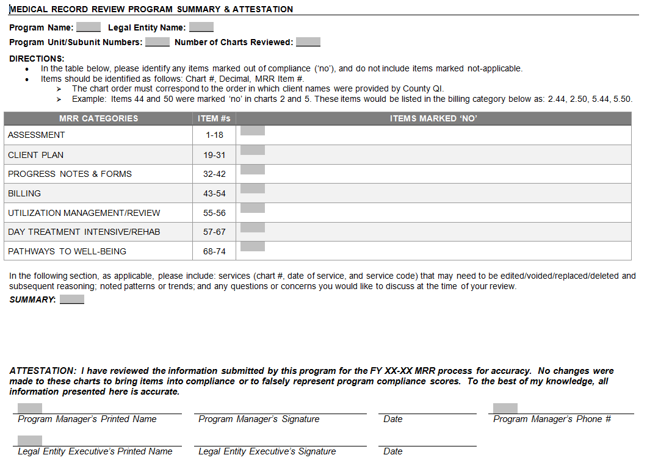

Slide 61
MRR Tool updates
13 | Within the past year (from date of current MRR), when a client has discharged from a 24 hour facility (Hospital, Crisis House) for DTS/DTO, a High Risk Assessment (HRA) is completed.
39 | For clients discharged from an inpatient/crisis residential facility, documentation evidences client was assessed in a timely manner, and if urgent service needed, client was seen by a mental health professional within 48 business hours, or documented why not.
44 | For clients prescribed controlled substances, there is documentation that the CURES database is reviewed upon initial prescription and at least once every 4 months thereafter if the substance remains part of the treatment plan.
 | SURVEY QUESTION ONLY: For A/OA clients prescribed controlled substances, a Patient Medication Agreement form was reviewed and signed by both client and Practitioner. Completed form is filed in hybrid chart.
 | SURVEY QUESTION ONLY: For CYF programs only. Any CANS outcome with a Need rating of "2 or 3" has supporting indicators referencing the BHA.

Slide 62
qm goals fy18-19
CLIENT PLAN COMPLIANCE WITH TIMELINES
AT ADMISSION – WITHIN 30 DAYS
ANNUAL OR UM
REDUCE DISALLOWANCE TO UNDER 5%
IMPROVE SYSTEM COMPLIANCE TO 92% PLUS
ZERO RECOUPMENTS – KEEP OUR FUNDING
DUE TO PAST 14 DAYS DOCUMENTATION
ZERO RECOUPMENTS FOR NO VALID CP

Slide 63
Client signatures
CP REQUIREMENTS:
CLIENT/LEGAL REP SIGNATURE AND DATE (if not available, go to #2)
DOCUMENTATION OF PARTICIPATION AND AGREEMENT
Documentation of participation in and agreement with the client plan may include reference in the client plan OR
A description in the medical record (e.g., in a progress note) of the beneficiary’s participation and agreement with the client plan.
The following is an example of a note that would meet the requirement:
Client participated in treatment planning meetings on (date) and (date). The client participated in developing their treatment plan goals; in particular, the goals for (state goal or goals that the beneficiary gave specific input for). The client was satisfied with the client plan and stated verbal agreement at the meeting held on (date).

Slide 64
How to operationalize
Assess your current work flow
Process mapping of intake process
Seek input from clients, staff, other providers
Be creative, brainstorm ideas
Make the necessary changes
Evaluate implemented changes
Make adjustments as necessary

Slide 65
QM Training FY17-18
TYPE | FY 17-18 OFFERED | FY 17-18 ATTENDED | FY 16-17 ATTENDED
A/OA OP DOC TRAINING | 4 | 113 | 148
CYF OP DOC TRAINING | 4 | 139 | 126
CYF PARENT/PEER PARTNER DOC TRAINING | 4 | 86 | 68
DAY TREATMENT DOC TRAINING | 0 | 0 | 11
CYF DT UNBUNDLING DOC TRAINING | 0 |  | 39
mHOMS DOC TRAINING | 0 | 0 | 127
ROOT CAUSE ANALYSIS TRAINING | 3 | 50 | 67
TOTAL | 15 | 388 | 586

Slide 66
ehr Training FY17-18
OPTUM TRAINING TEAM | CLASSES OFFERED | NUMBER ATTENDED
CCBH (Cerner) | 495 | 2524
Since October 2009 | 3,026 | 18,492
Overall Satisfactions since Oct. 2009 | 95%

Slide 67
Access times

Slide 68
MEDICATION MONITORING (3 Qtrs.)
 | CYF | A/OA | TOTAL
Programs Reporting | 66 | 44 | 110
Charts with Meds | 3,699 | 24,430 | 28,129
Charts Reviewed | 221 (6%) | 384 (2%) | 635 (2%)
# Variances & % of possible variances in reviewed charts | 71 (1%) | 174 (1%) | 245 (1%)
Majority of Variances:
Labs
Informed Consent completion
Number of each chemical class concurrently without a
clearly documented rationale
Med Monitoring practices will be reviewed onsite by the QM Specialist during the Medical Record Review process.

Slide 69
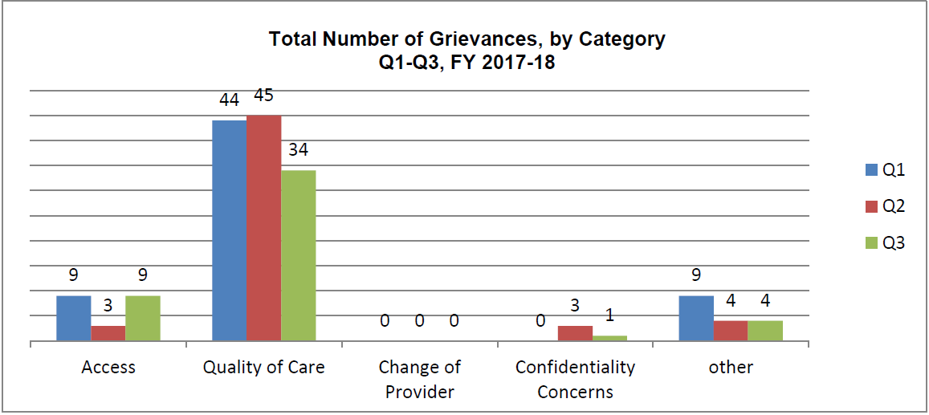
Beneficiary rights: grievances
Focus for Improvement
Staff Behavior, Treatment Issues, Medication, Patients’ Rights
There were no Appeals for FY17-18

Slide 70
SERIOUS INCIDENTs (as of 5/31/18)
Death Under Questionable
Confirmed Inappropriate Staff
Injurious Assault on a Client
Apparent Overdose of
Injurious Assault by a Client
Tarasoff (Report made by
Incident in Media
Homicide Attempt by a Client
Tarasoff (Report received by
Serious Physical Injury
Physical Restraints (Prone or
Death by Suicide
Suicide Attempt
Alcohol/Drugs
Supine)
Death by Homicide
Program)
Serious Allegations of or
Circumstances
Program)
Bx
Other
Totals
A/OA
11
13
19
1
41
2
1
0
38
3
2
13
14
0
17
203
CYF
10
0
0
0
22
1
0
0
3
0
1
3
5
130
5
197
TOTAL
21
13
19
1
63
3
1
0
41
3
3
16
19
130
22
400
SOC

Slide 71
Privacy incident reporting
Effective Monday June 25th, 2018, the Compliance Office transitioned to an online web-form version of the HHSA Privacy Incident Report (PIR). The web portal is live and you are encouraged to begin using it to report new PIRs going forward. To open the web-form, click the text link Submit a Privacy Incident Report from the landing page.
LANDING PAGE BELOW
https://www.sandiegocounty.gov/content/sdc/hhsa/hhsa-privdb-landing.html
Upon submitting the online web-form, the submitter will receive an email with a PIR Tracking Number (PIR—####) and Access Code ID#. Use this information to access & update pending PIRs until the report is complete.
Please reference the PIR Tracking Number in the email subject line when communicating with the Compliance Office regarding reported incident, including providing additional requested information, draft incident notification letters, etc.
ALL suspected and actual privacy incident reports must be submitted via the online web portal effective August 1, 2018. As of 8/1/2018, the PIR Word document will no longer be accepted.
No longer reported to QM as a Serious Incident; no need to phone it in to QM.

Slide 72
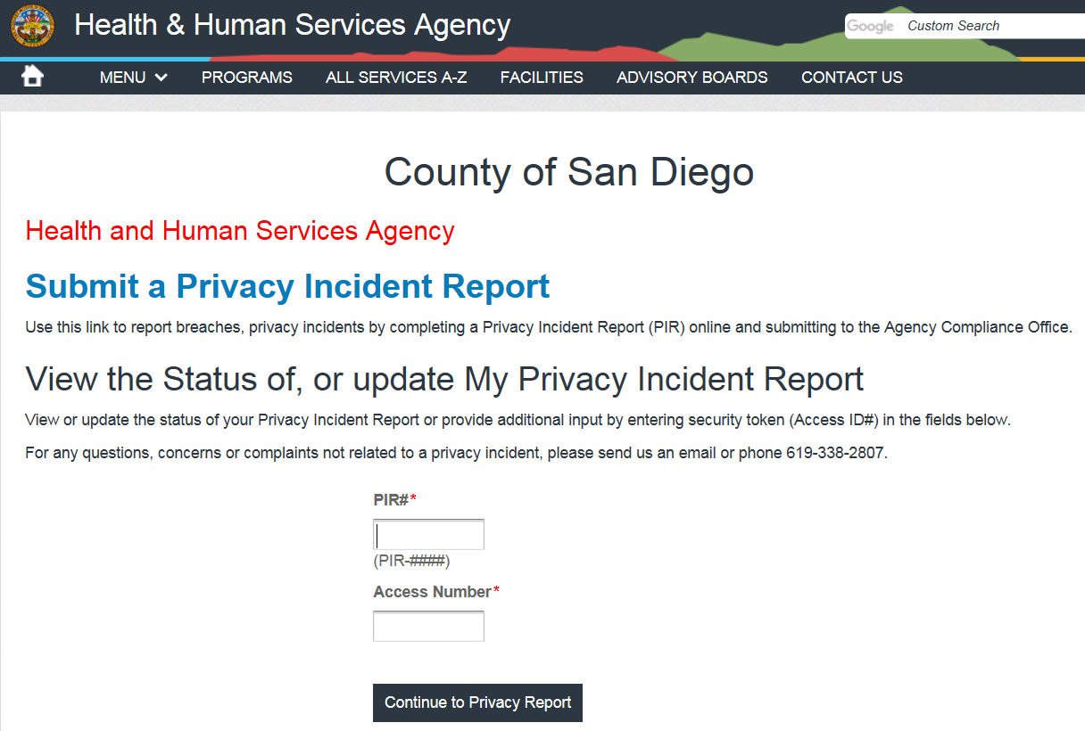
Privacy incident reporting

Slide 73
Cures 2.0
Consultation Mandate timeline
Department of Justice (DOJ) maintains the Controlled Substance Utilization and Evaluation System (CURES) in order to electronically monitor Schedule II, III, IV controlled substance prescriptions dispensed in California.
SB 482 requires health care practitioners to consult the CURES database to review client’s controlled substance history.
As of April 2, 2018 the CURES 2.0 database is ready for statewide use.
While the statewide CURES 2.0 consultation requirement is effective as of October 2, 2018, County of San Diego Behavioral Health Service providers are required to integrate this mandate into their current prescriptive regimen as of FY 18-19 beginning July 1, 2018.

Slide 74
Cures 2.0
consultation requirements
Pursuant to Health and Safety Code section 11165.4(a), the mandatory consultation requirement indicates that health care practitioners review the CURES 2.0 database to evaluate a patient's controlled substance history under both of the following situations:
Prior to prescribing a Schedule II, III, and IV controlled substance for the first time.
At least once every 4 months thereafter if substance remains a part of treatment.

Slide 75
Cures 2.0
Cures consultation requirements
This requirement applies to any health care practitioner with both of the following:
Drug Enforcement Administration (DEA) Controlled Substance Registration Certificate.
California licensure as one of the following:
Medical Physician
Physician Assistant
Registered Nurse Practitioner (Furnishing)
Dentist
Naturopathic Physician
Optometrist
Osteopathic Physician
Podiatrist
Registered Certified Nurse Midwife
**While pharmacists have access to the CURES 2.0 database, the mandatory consultation requirement does not apply to these particular health care practitioners.**

Slide 76
Cures 2.0
Documentation requirements
All organizational providers with health care practitioners authorized to prescribe, order, administer, or furnish Schedule II, III, and IV controlled substances shall ensure compliance with and documentation of CURES 2.0 consultation requirements.
Medication Progress Notes
Progress note documentation shall attest to the prescribing health care practitioner’s review the CURES 2.0 database, when applicable, within the required timelines.
Medication progress note templates include the following prompt “Review of CURES Database.”

Slide 77
Cures 2.0
Documentation requirements
Medication Monitoring
Medication Monitoring Tool has been updated with questions that reflect the CURES 2.0 consultation mandate.
The Medication Monitoring Committee shall attest to their peer’s review of the CURES 2.0 database by answering the corresponding questions on the Medication Monitoring tool when applicable.
A/OA Patient Medication Agreement
This is an optional form for A/OA clients receiving Schedule II, III, IV controlled substances in addition to the Informed Consent for Psychotropic Medications. It is not applicable to CYF clients.

Slide 78
Cures 2.0
QM monitoring
At the time of your Medical Record Review (MRR), QM Specialist will review the following:
Medication progress notes for review of CURES database when applicable.
Informed Consent for Psychotropic Medications form.
Medication Monitoring process and forms for the past fiscal year.

Slide 79
Quick updates & reminders
When reporting Serious Incidents, report client name, CCBH ID, date of incident, specific details about incident.
BHA – ADULT WALK IN assessment may be used by Outpatient Clinics with “Walk In” designated hours. This is only for adult clinics with designated “walk in” hours. The full BHA – ADULT assessment is expected when the annual BHA update is due or there is an update to the BHA needed.
Quarterly Status Reports – updated NOABD and Suggestions & Transfer Tabs
MRR Tool – Billing Summary split into two tabs, one for Recoupments and one for Corrections
New Medication Monitoring Tab
Prospective Risk Analysis (PRA)

Slide 80
PROGRAM INTEGRITY
Training and regular monitoring activities are your best practices
BHS SOC

Slide 81
PROGRAM INTEGRITY
Fraud: an intentional act of deception, misrepresentation, or concealment in order to gain something of value
Waste: over-utilization of services (not caused by negligent actions) or the misuse of resources
Abuse: excessive or improper use of services or actions that is inconsistent with acceptable business or medical practices
Question: If you know the tools to use to prevent waste and abuse and you do not use them, who’s responsible? Are you making a good faith effort to minimize risk?

Slide 82
PROGRAM INTEGRITY
BILLING REVIEW REPORTS – daily/weekly
Duplicate Services Report
Billing Suspense Report
Client Services Report
Program Monitoring by Staff Report
Non-final Approved Progress Notes

Slide 83
PROGRAM INTEGRITY
PROGRAM MONITORING – weekly/monthly
Timeliness of Service Entry
Service Exception Report
No Show Summary Report
Client Diagnosis Report
Assessments Not Final Approved
Client Plans Not Final Approved

Slide 84
On the horizon
Individual Basic Doc Training Modules posted on Optum, available any time for staff
Create individual “practice” trainings for specific topics like progress notes writing, understanding service codes, writing effective client plans.
Quick Guide for Doc & Billing Standards

Slide 85
Performance Improvement Team
Notes:
Metrics: A method of measuring something, or the results obtained from this.

Slide 86
QI Workplan
QIWP Target Area: Services Are Client Centered
Decrease the number of Quality of Care related grievances by 5%.
Evaluate changes from FY 2013-14 baseline in satisfaction, engagement, and career opportunities among Support Specialists in the BHS system.
Implement new Outcome Tools in the CYF System of Care—Child and Adolescent Needs and Strengths (CANS) and Pediatric Symptom Checklist (PSC-35)—and determine baseline data.

Slide 87
QI Workplan
QIWP Target Area: Services Are Safe
Decrease the number of completed suicides in the Behavioral Health System of Care by 5% from the previous Fiscal Year.
100% of programs meet the medication monitoring review requirement (1% each quarter).
Increase Psychiatric Emergency Response Team (PERT) clinicians from 40 to 50.

Slide 88
QI Workplan
QIWP Target Area: Services Are Effective
Ensure that 60% of Full Service Partnership (FSP) Project One for All (POFA) clients are in permanent housing at the latest assessment compared to intake.
Increase the number of clients discharged from a psychiatric hospital who connect to services within 7 and within 30 days after discharge by 5% from last Fiscal Year to provide effective continuity of care.

Slide 89
QI Workplan
QIWP Target Area: Services Are Efficient and Accessible
Provide specialty mental health services to 2% (12,923 clients) of county uninsured or Medi-Cal under 200% Federal Poverty Level (FPL) eligible population.
Relocate youth crisis stabilization beds to Central region and expand from 4 to 12 beds.

Slide 90
QI Workplan
QIWP Target Area: Services Are Equitable
100% of clients and families indicating in the State-required Consumer Perception Surveys that they had access to written info in their primary language and/or received services in the language they prefer.
100% of requests from all races/ethnicities meet the systemwide access time standard of 5 days for CYF clients and 8 days for A/OA clients.
100% of requests in all preferred languages meet the systemwide access time standard of 5 days for CYF clients and 8 days for A/OA clients.

Slide 91
QI Workplan
QIWP Target Area: Services Are Timely
95% of calls answered by the Access and Crisis Line (ACL) crisis queue are within 45 seconds.
Average speed to answer all other (non-crisis) calls is within 60 seconds.
100% of CYF programs meet the mental health assessment timeliness standard (5 days).
100% of A/OA programs meet the mental health assessment timeliness standard (8 days).
100% of CYF and A/OA programs meet the timeliness standard for mental health assessment requests deemed as urgent (72 hours).

Slide 92
Cultural Competence
BHS identified and developed two new assessment tools:
Organizational Assessment: Cultural and Linguistic Competence Policy Assessment (CLCPA) – replaced the Culturally Competent Program Annual Self-Evaluation (CC-PAS)
Individual/Staff Assessment: Promoting Cultural Diversity Self-Assessment Checklist (PCDSA) – replaced the California Brief Multicultural Competence Scale (CBMCS)

Slide 93
Cultural Competence
CLCPA (Cultural and Linguistic Competence Policy Assessment)
Issued to all Program Managers in October 2017
193 responses
141 Mental Health
52 Substance Use Disorder
Sections:
Knowledge of Diverse Communities
Organizational Philosophy
Personal Involvement in Diverse Communities
Resources and Linkages
Human Resources
Language and Interpretation Services Access
Engagement of Diverse Communities

Slide 94
Cultural Competence
Findings:
Respondents are fairly or very familiar with the diverse communities and the demographic makeup of their service areas
There was a relatively wide distribution of levels of personal and program staff involvement in the communities’ culturally diverse activities
Nearly half the respondents indicated that their organizations do not have procedures to achieve the goal of a culturally and linguistically competent workforce that includes either staff recruitment, hiring, retention, or promotion
Respondents stated that the organizations’ staff are relatively diverse culturally and linguistically, with the Peer Support Specialists and Support staff being the most diverse, while the board members and the executive management being the least diverse
According to the respondents, the programs use trained medical interpreters more regularly than the certified medical interpreters or sign language interpreters. However, nearly a quarter of the respondents indicated that their organizations never or seldom evaluate the quality and effectiveness of these services
Technical assistance (TA) requests were mostly related to the CLAS Standards, beneficiary materials, community resources, and training opportunities

Slide 95
Cultural Competence
Next Steps:
The CLCPA results will be disseminated systemwide.
To Programs and CORs
Ensure the CLCPA supports the BHS’ commitment for a culturally and linguistically responsive workforce.
The next CLCPA will be administered in October 2018. The data will be trended during the analysis of the results, and the noteworthy findings will be highlighted in the report.

Slide 96
Cultural Competence
PCDSA (Promoting Cultural Diversity Self-Assessment Checklist)
Issued to all Staff in February 2018
2,672 responses
2,195 Mental Health
477 Substance Use Disorder
Sections:
Physical Environment, Materials, and Resources
Communication Styles
Values and Attitudes

Slide 97
Cultural Competence

Slide 98
Cultural Competence
Findings:
System most confident in:
I understand and accept that family is defined differently by different cultures (e.g., extended family members, godparents, family of choice).
I accept and respect that gender roles and expression of gender identity in families may vary significantly among different cultures.
I recognize that the meaning or value of behavioral health outreach, prevention, intervention, and treatment may vary greatly among cultures.
I recognize and understand that beliefs and concepts of emotional well-being vary significantly from culture to culture.
I understand that beliefs about mental illness, substance use, and emotional disability are culturally-based. I accept that responses to these conditions and related services are heavily influenced by culture.

Slide 99
Cultural Competence
Findings:
System least confident in:
When offering food, I ensure that meals provided include foods that are unique to the cultural and ethnic backgrounds of the communities served by my program or agency.
Even though my professional or moral viewpoints may differ, I accept the family/parents as the ultimate decision makers for services and supports for their children.
I display pictures, posters, and other materials that reflect the cultures and ethnic backgrounds of communities served by my program or agency.
I ensure mediums and modalities in reception areas and those, which are used during program services, are representative of the various cultural and ethnic groups within the local community and the society in general.
I ensure that magazines, brochures, and other printed materials in reception areas are of interest to and reflect the different communities served by my program or agency.

Slide 100
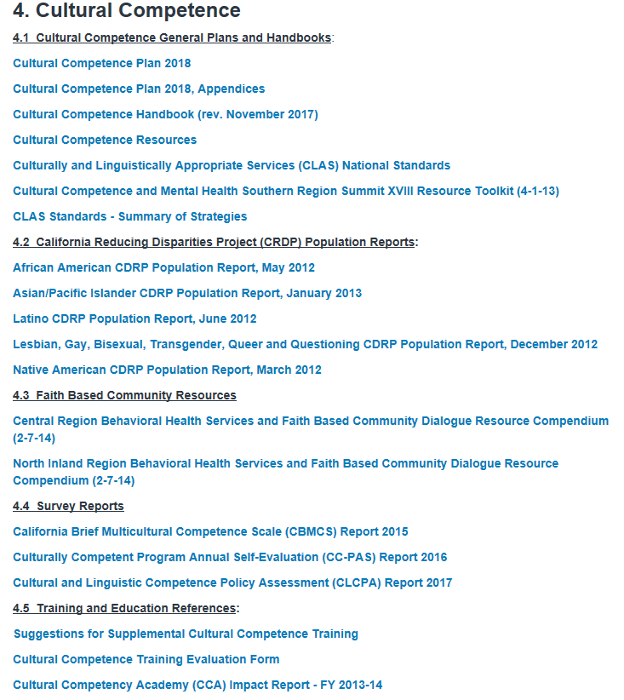
Cultural Competence
Resource:
Technical Resource Library:
https://www.sandiegocounty.gov/content/sdc/hhsa/programs/bhs/technical_resource_library.html

Slide 101
Questions?
For more information or reports, contact BHSQIPIT@sdcounty.ca.gov.
Liz Miles, QI Performance Improvement Team (PIT) Elizabeth.miles@sdcounty.ca.gov

Slide 102
Management Information Systems
Notes:
Metrics: A method of measuring something, or the results obtained from this.

Slide 103
Access To Services Journal
MIS has changed the way we collect Access to Services data

Slide 104
Access To Services Journal
Cerner Community Behavioral Health (CCBH) now contains the Access to Services Journal
Data is collected within the CCBH system
Administrative staff will enter data as it is gathered
Clinical staff and Program Managers will continue to enter data into the updated Excel spreadsheet
Administrative staff will enter data into CCBH
This data will be entered by close of next business day

Slide 105
Access To Services Journal
Improvement
Ease of access
Better monitoring and tracking of data
Provider report for data integrity checks

Slide 106
Access To Services Journal
What has changed?
We now collect Access to Services data electronically.
The same policies and procedures for collecting data apply.
The updated Excel spreadsheet is for data collection only and is not to be submitted to QM at month end.
Reports will be generated from CCBH going forward.

Slide 107
Access To Services Journal
The Access to Services Journal Tip Sheet and Tutorial has been posted to the Optum website:
https://www.optumsandiego.com/content/sandiego/en/asj.html

Slide 108
Access To Services Journal
For questions or comments please contact:
QIMatters.HHSA@sdcounty.ca.gov

Slide 109
Data Integrity
Please pay special attention to the data you enter into CCBH.
We use this data to provide the best possible service to our clients.

Slide 110
Data Integrity
Incorrect data can have many ill-effects on the client record.
Make every effort to maintain data integrity.
Monitor and perform clean-up efforts on important data fields such as the client address.
Notes:
Provide Client Address issues.

Slide 111
MIS

