Slide 1
Medi-Cal Denied Claims Report
County of San Diego

Slide 2
Information on this report?
Will Information on the denial report ever go away? -NO
What is the purpose of this report? -For you to understand why services were denied and determine what actions you can take.
What actions can I take with services on this report? -You can only replace or invalidate services on this report (2 different forms)- but they will never go away.
Can a service be recalculated to get “fixed”?
-No. Once a service has been claimed it is no
longer an option.

Slide 3
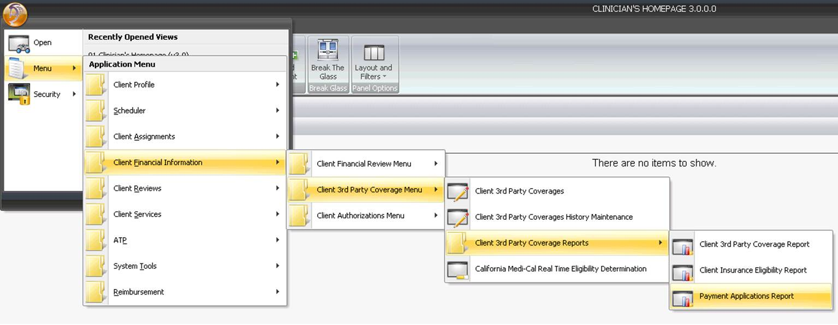
Running your report

Slide 4
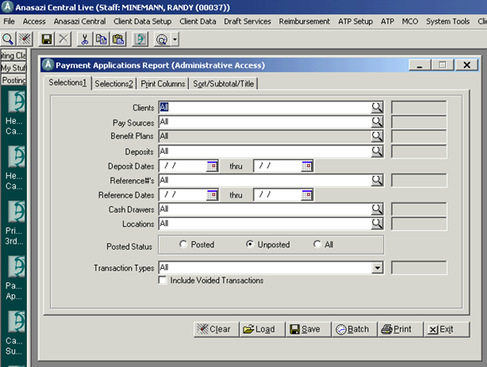
Running your report
Click on the Load button

Slide 5
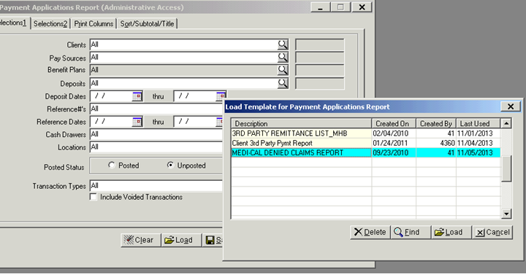
Running your report
A pop-up window will open.
Click on Medi-Cal Denied Claims Report to highlight and click the Load button

Slide 6
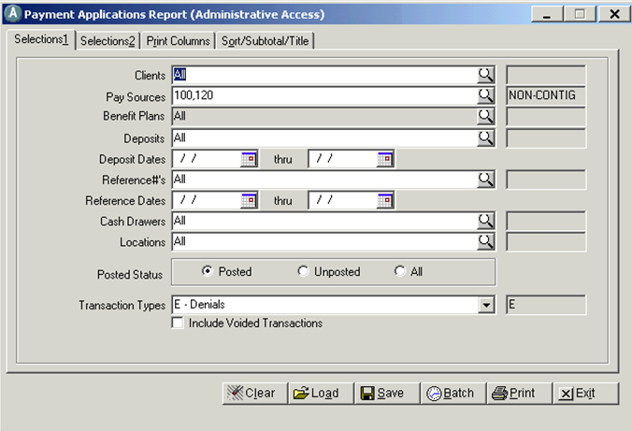
Running your report tab 1
The following pay sources will populate
Reference dates refer to when an EOB was received and posted by the MHBU in Anasazi. (optional)
The status should be posted
The Transaction Type should populate E-Denials

Slide 7
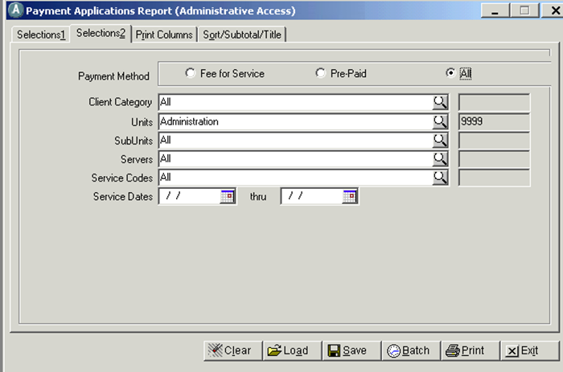
Running your report tab 2
Administration will auto populate but you should change this to YOUR Unit/Subunit
Enter to and from dates for the service period you can correct and bill.

Slide 8
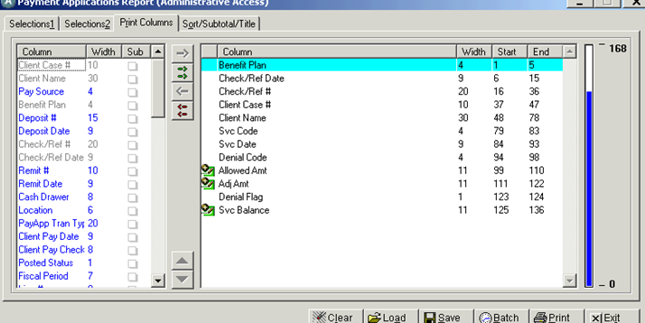
Running your report
Print Columns
can add unit/subunit or Leave this as is

Slide 9
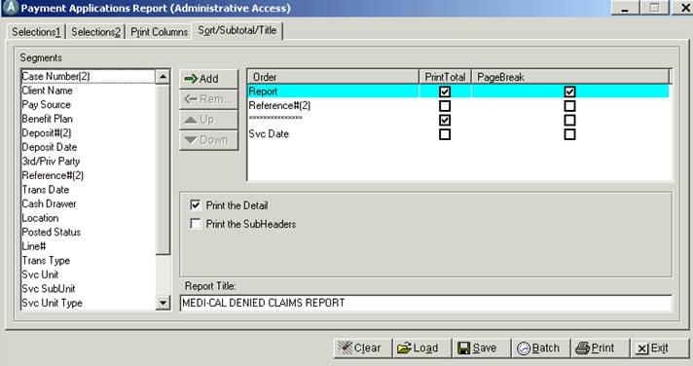
Running your report
Sort/Subtotal/Title
Click on Print

Slide 10
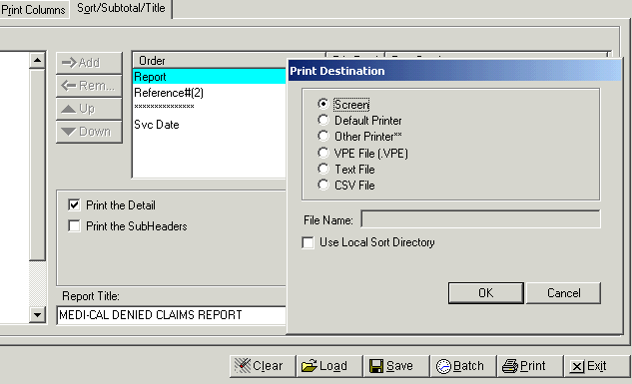
This pop-up will show:
Destination= Screen
Then click OK button.

Slide 11
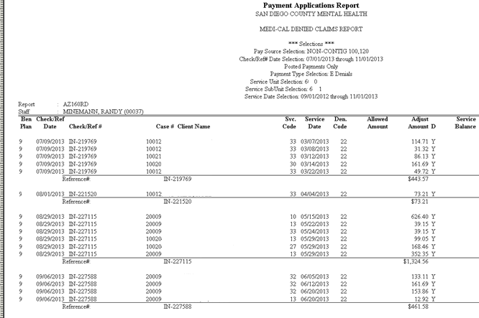
Report

Slide 12
What now?
Check the denial code definition.
Determine if the service can be; replaced (must be within 15 months from service date), Invalidated if the service is not to count in TUOS.
A denied claim will always require forms to be submitted if something needs to be corrected. (recalculation can not be performed).
Fill out the proper paperwork, attach all pertinent information and submit your request to the MHBU.
Check that your request has been processed in Anasazi

